Slide 1
Multi-User Collusion-Resistant Searchable Encryption
with Optimal Search Time
Yun Wang/Dimitrios Papadopoulos
ASIA CCS ‘21: Proceedings of the 2021 ACM Asia Conference on Computer and Communications Security
汇报人：魏佩

Slide 2


















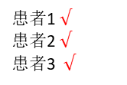




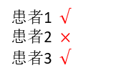





MUSSE System Model/Collusion Resistant
Data owner
Cloud Server
$${id}_{3}$$
$${id}_{4}$$
$${id}_{1}$$
$${id}_{2}$$
$${id}_{1}$$
$${id}_{3}$$
$${id}_{2}$$
$${id}_{4}$$
$$K_{A},w_{1}$$
$$w_{1}$$
检索陷门
$$K_{B}$$
$$K_{A}$$
$$K_{B},w_{2}$$
$${id}_{1}$$
用户
$${id}_{3}$$
Cloud Server
$${id}_{1}$$
$${id}_{2}$$
$${id}_{4}$$
$${id}_{3}$$
用户A
用户B
Figure 1 SUSSE system model
Figure 3 MUSSE system model
患者1$√$
患者2$×$
患者3 $√$
医院1
$$w_{1}$$
$${id}_{1}$$
$${id}_{3}$$
医院2
患者1$√$
患者2$√$
患者3 $√$
患者1
$$w_{2}$$
$${id}_{4}$$
$${id}_{3}$$
$${id}_{2}$$
$${id}_{1}$$
Cloud Server
$$w_{3}$$
$${id}_{2}$$
$${id}_{3}$$
$${id}_{4}$$
医院3
患者1$√$
患者2$×$
患者3 $×$

Slide 3

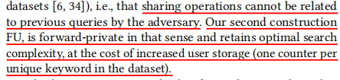
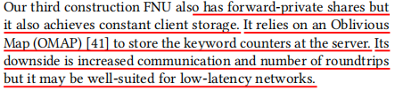





NFNU/FU/FNU
NFNU: (No Forward Privacy and No User Storage)
•
$$({id}_{1},w_{1})$$
FU:(Forward Private and Requires User Storage)
$$t_{1}$$
•
insert
$$w_{1}$$
用户
$$t_{2}$$
search
Cloud Server
FNU:(Forward Privacy and Low User Storage)
$$({id}_{2},w_{1})$$
•
$$t_{3}$$
insert
Insertion during $t_{3}$ cannot
be linked to search in $t_{2}$

Slide 4
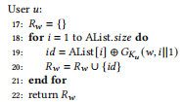

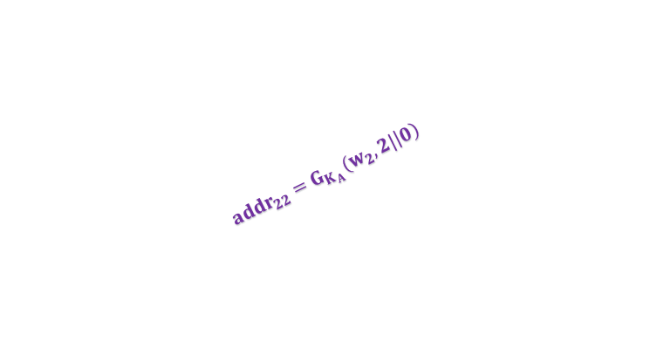
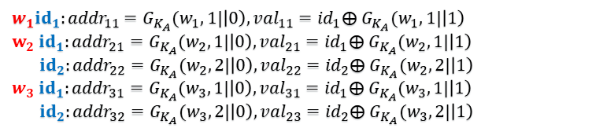
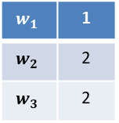
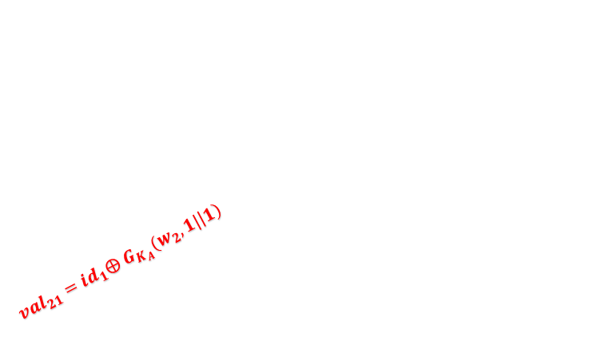

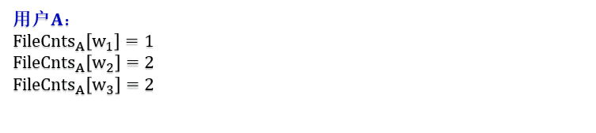
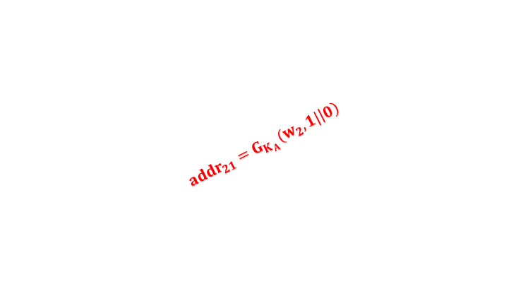

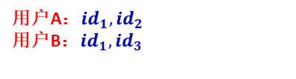

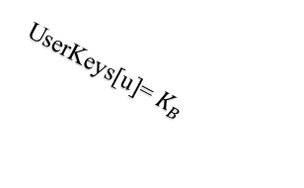
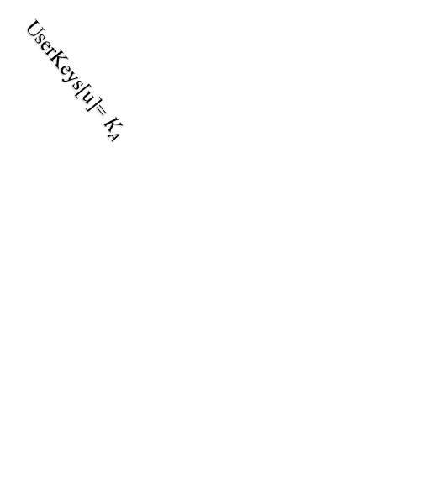

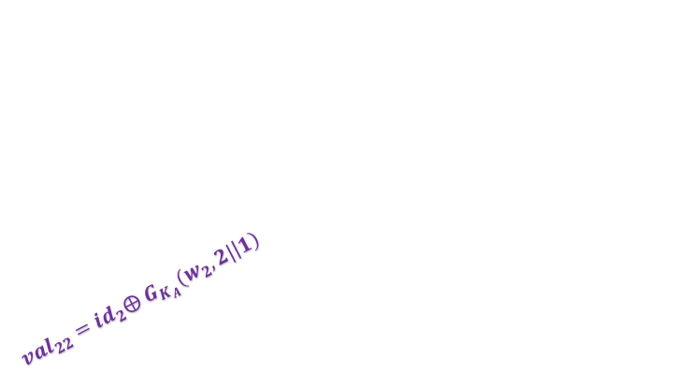
NFNU(No Forward Privacy and No User Storage)
$w_{1}{id}_{1}{:addr}_{11}=G_{K_{A}}(w_{1},1|\left|0\right),{val}_{11}={id}_{1}⨁$ $G_{K_{A}}(w_{1},1|\left|1\right)$
$w_{2}$ ${id}_{1}:{addr}_{21}=G_{K_{A}}(w_{2},1|\left|0\right),{val}_{21}={id}_{1}⨁$ $G_{K_{A}}(w_{2},1|\left|1\right)$
${ id}_{2}:{addr}_{22}=G_{K_{A}}(w_{2},2|\left|0\right),{val}_{22}={id}_{2}⨁$ $G_{K_{A}}(w_{2},2|\left|1\right)$
$w_{3}{ id}_{1}:{addr}_{31}=G_{K_{A}}(w_{3},1|\left|0\right),{val}_{31}={id}_{1}⨁$ $G_{K_{A}}(w_{3},1|\left|1\right)$
${ id}_{2}:{addr}_{32}=G_{K_{A}}(w_{3},2|\left|0\right),{val}_{23}={id}_{2}⨁$ $G_{K_{A}}(w_{3},2|\left|1\right)$
用户A$：{Access}_{A}=\{{id}_{1},{id}_{2}$}
Data owner
DictW
Cloud Server
Setup (addr,val) pairs
$$w_{1}$$
$${id}_{1}$$
$${id}_{3}$$
Share (addr,val) pairs
用户$A：$
${FileCnts}_{A}\left[w_{1}\right]=1$
$${FileCnts}_{A}\left[w_{2}\right]=2$$
$${FileCnts}_{A}\left[w_{3}\right]=2$$
用户A：${id}_{1},$ ${id}_{2}$
用户B：${id}_{1},$ ${id}_{3}$
$$w_{2}$$
$${id}_{2}$$
$${id}_{1}$$
${val}_{21}={id}_{1}⨁$ $G_{K_{A}}(w_{2},1|\left|1\right)$
$${id}_{3}$$
$${id}_{2}$$
Counter
$$w_{3}$$
$${id}_{1}$$
$${addr}_{21}=G_{K_{A}}(w_{2},1|\left|0\right)$$
$$w_{1}$$ | 1
$$w_{2}$$ | 2
$$w_{3}$$ | 2
${val}_{22}={id}_{2}⨁$ $G_{K_{A}}(w_{2},2|\left|1\right)$
UserKeys[u]= $K_{B}$
$${addr}_{22}=G_{K_{A}}(w_{2},2|\left|0\right)$$
Stop message
Owner本地$存储：$
$σ=\{FileCnts$, UserKeys, $Access$}
用户A$：{Access}_{A}=\{{id}_{1},{id}_{2}$}
用户B$：{Access}_{B}=\{{id}_{1},{id}_{3}\}$
UserKeys[u]= $K_{A}$
用户A
用户B

Slide 5
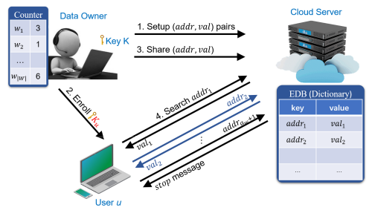
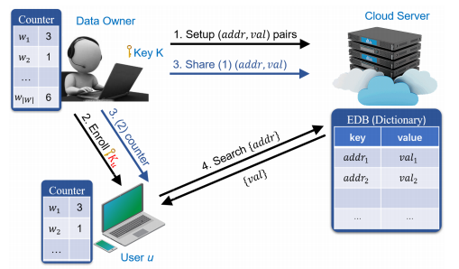
FU(Forward Private and Requires User Storage)
NFNU: our NFNU scheme does not achieve forward privacy with respect to shares, as the users do not know the exact value of the document counter for the keyword they are searching.
FU:Our modification is rather straight forward as we store the counters locally at the user’s side.
Figure 1:Model of NFNU
Figure 2:Model of FU

Slide 6
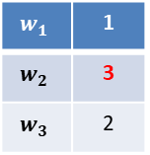
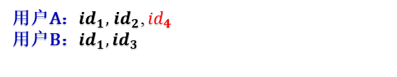
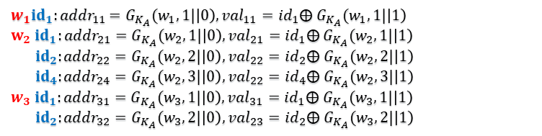
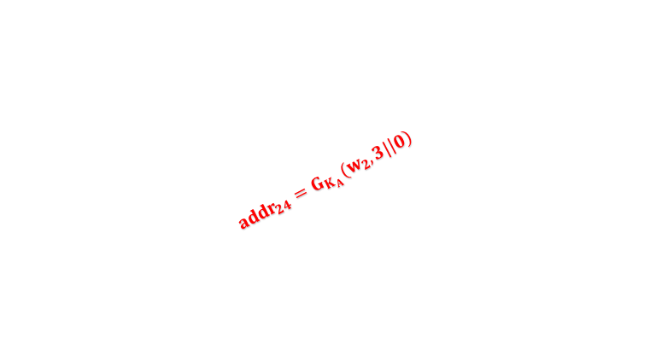


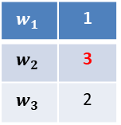
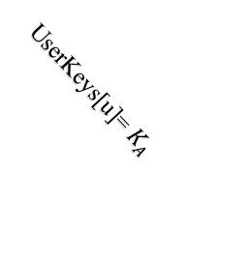
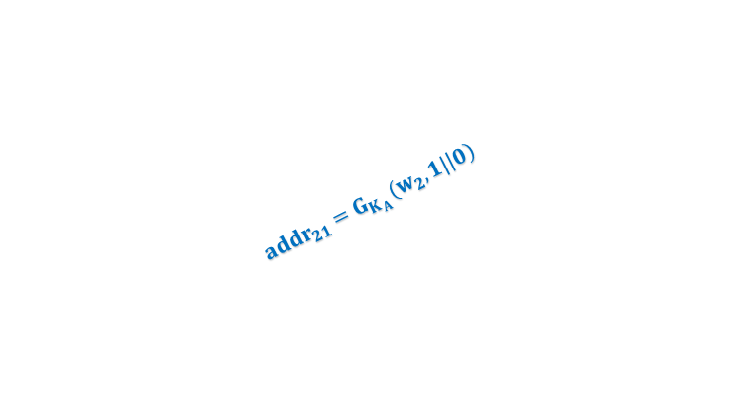
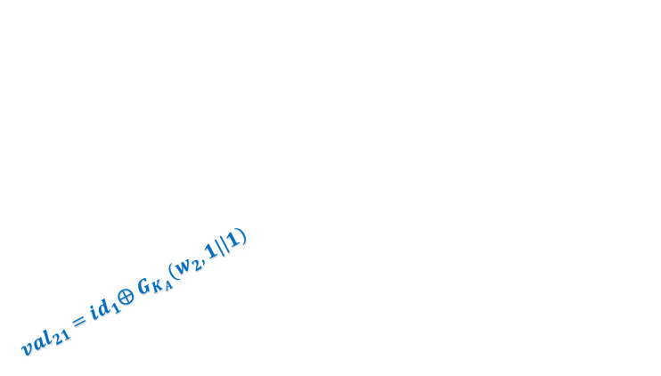
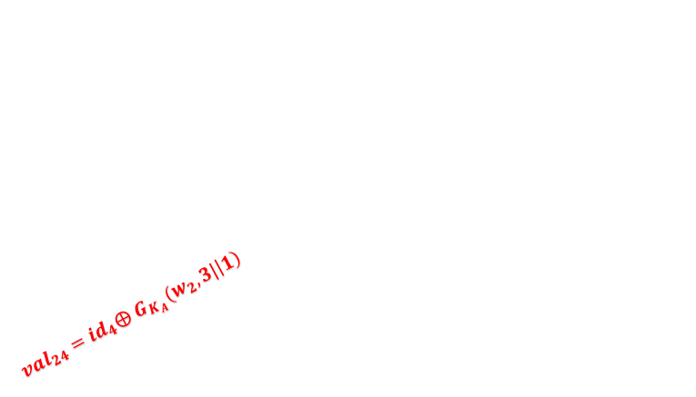
FU(Forward Private and Requires User Storage)
$w_{1}{id}_{1}{:addr}_{11}=G_{K_{A}}(w_{1},1|\left|0\right),{val}_{11}={id}_{1}⨁$ $G_{K_{A}}(w_{1},1|\left|1\right)$
$w_{2}$ ${id}_{1}:{addr}_{21}=G_{K_{A}}(w_{2},1|\left|0\right),{val}_{21}={id}_{1}⨁$ $G_{K_{A}}(w_{2},1|\left|1\right)$
${ id}_{2}:{addr}_{22}=G_{K_{A}}(w_{2},2|\left|0\right),{val}_{22}={id}_{2}⨁$ $G_{K_{A}}(w_{2},2|\left|1\right)$
${ id}_{4}:{addr}_{24}=G_{K_{A}}(w_{2},3|\left|0\right),{val}_{22}={id}_{4}⨁$ $G_{K_{A}}(w_{2},3|\left|1\right)$
$w_{3}{ id}_{1}:{addr}_{31}=G_{K_{A}}(w_{3},1|\left|0\right),{val}_{31}={id}_{1}⨁$ $G_{K_{A}}(w_{3},1|\left|1\right)$
${ id}_{2}:{addr}_{32}=G_{K_{A}}(w_{3},2|\left|0\right),{val}_{23}={id}_{2}⨁$ $G_{K_{A}}(w_{3},2|\left|1\right)$
用户A$：{Access}_{A}=\{{id}_{1},{id}_{2},{id}_{4}$}
Data owner
DictW
Cloud Server
Setup (addr,val) pairs
Counter
$$w_{1}$$
$${id}_{1}$$
$${id}_{3}$$
Share (addr,val) pairs
$$w_{1}$$ | 1
$$w_{2}$$ | 3
$$w_{3}$$ | 2
用户A：${id}_{1},$ ${id}_{2}$, ${id}_{4}$
用户B：${id}_{1},$ ${id}_{3}$
$$w_{2}$$
$${id}_{4}$$
$${id}_{2}$$
$${id}_{1}$$
${val}_{21}={id}_{1}⨁$ $G_{K_{A}}(w_{2},1|\left|1\right)$
${val}_{24}={id}_{4}⨁$ $G_{K_{A}}(w_{2},3|\left|1\right)$
$${id}_{3}$$
$${id}_{2}$$
$$w_{3}$$
$${id}_{1}$$
$${addr}_{21}=G_{K_{A}}(w_{2},1|\left|0\right)$$
${val}_{22}={id}_{2}⨁$ $G_{K_{A}}(w_{2},2|\left|1\right)$
$${addr}_{24}=G_{K_{A}}(w_{2},3|\left|0\right)$$
Owner本地$存储：$
$σ=\{FileCnts$, UserKeys, $Access$}
用户A$：{Access}_{A}=\{{id}_{1},{id}_{2}$, ${id}_{4}$}
用户B$：{Access}_{B}=\{{id}_{1},{id}_{3}\}$
UserKeys[u]= $K_{B}$
$${addr}_{22}=G_{K_{A}}(w_{2},2|\left|0\right)$$
UserKeys[u]= $K_{A}$
$$w_{1}$$ | 1
$$w_{2}$$ | 3
$$w_{3}$$ | 2
用户A
用户B

Slide 7
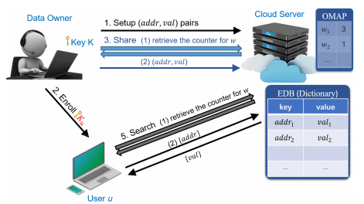

FNU(Forward Privacy and Low User Storage)
$${OMAP}_{A}$$
Figure 1:Model of FU
Figure 2:Model of FNU

Slide 8

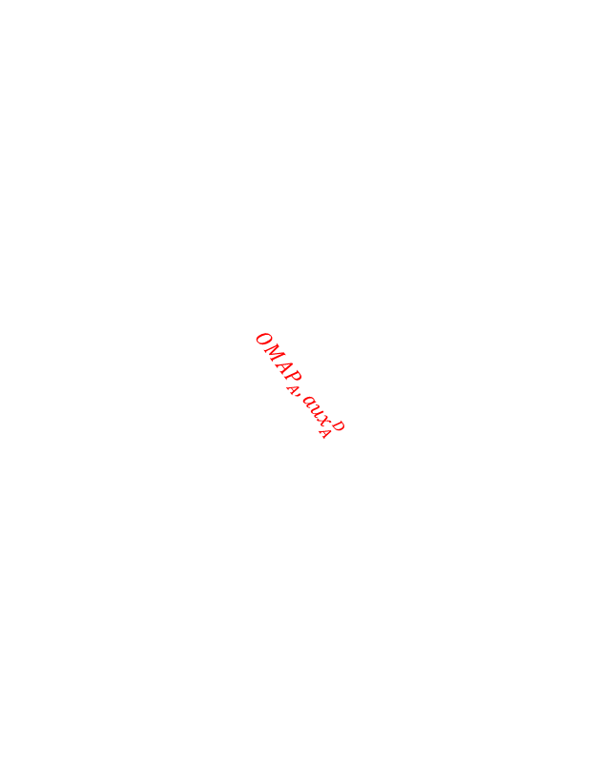
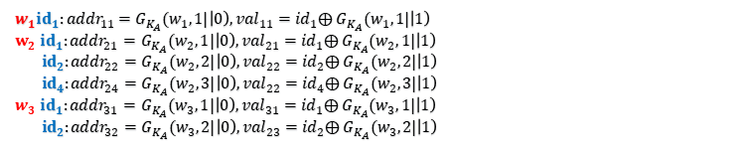
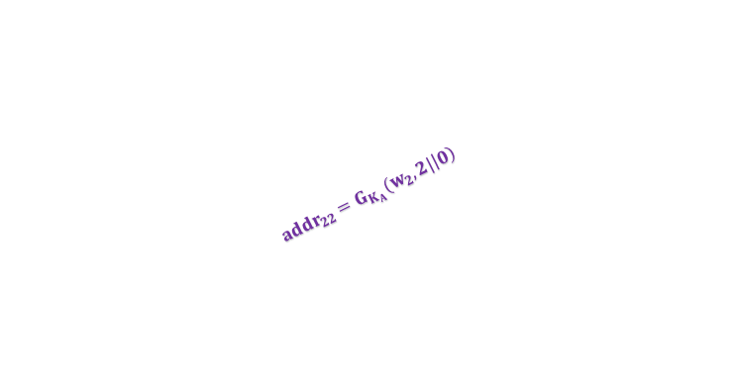
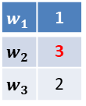
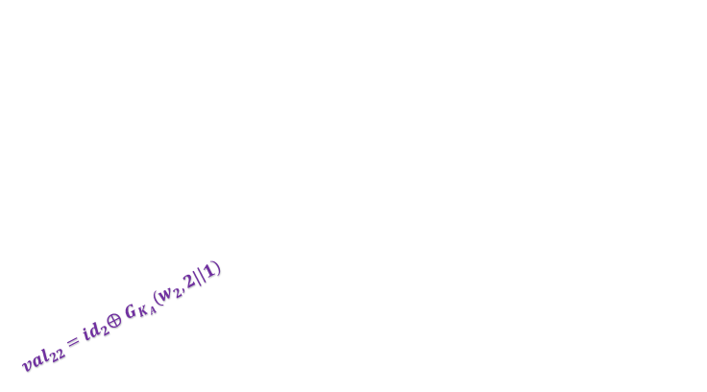

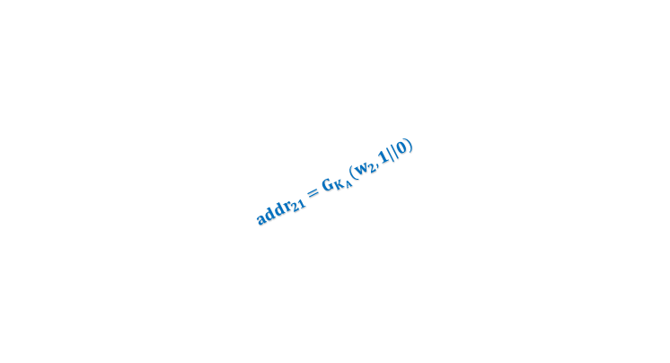


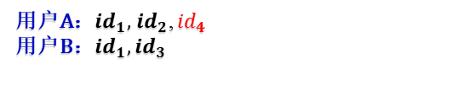
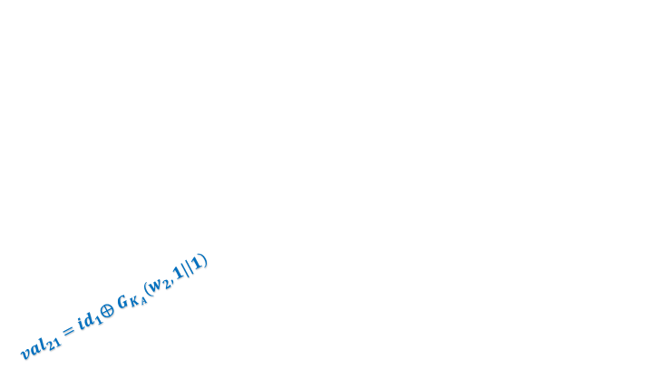
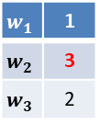
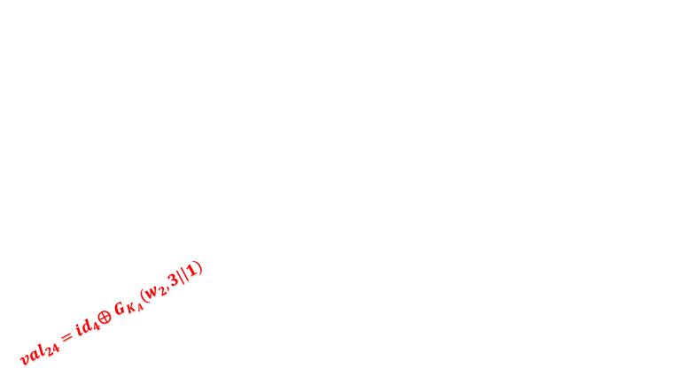
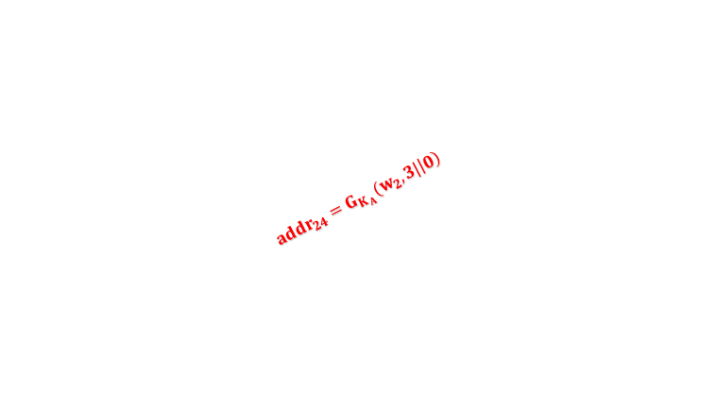

FNU(Forward Privacy and Low User Storage)
$w_{1}{id}_{1}{:addr}_{11}=G_{K_{A}}(w_{1},1|\left|0\right),{val}_{11}={id}_{1}⨁$ $G_{K_{A}}(w_{1},1|\left|1\right)$
$w_{2}$ ${id}_{1}:{addr}_{21}=G_{K_{A}}(w_{2},1|\left|0\right),{val}_{21}={id}_{1}⨁$ $G_{K_{A}}(w_{2},1|\left|1\right)$
${ id}_{2}:{addr}_{22}=G_{K_{A}}(w_{2},2|\left|0\right),{val}_{22}={id}_{2}⨁$ $G_{K_{A}}(w_{2},2|\left|1\right)$
${ id}_{4}:{addr}_{24}=G_{K_{A}}(w_{2},3|\left|0\right),{val}_{22}={id}_{4}⨁$ $G_{K_{A}}(w_{2},3|\left|1\right)$
$w_{3}{ id}_{1}:{addr}_{31}=G_{K_{A}}(w_{3},1|\left|0\right),{val}_{31}={id}_{1}⨁$ $G_{K_{A}}(w_{3},1|\left|1\right)$
${ id}_{2}:{addr}_{32}=G_{K_{A}}(w_{3},2|\left|0\right),{val}_{23}={id}_{2}⨁$ $G_{K_{A}}(w_{3},2|\left|1\right)$
用户A$：{Access}_{A}=\{{id}_{1},{id}_{2},{id}_{4}$}
Data owner
DictW
Cloud Server
Setup (addr,val) pairs
$$w_{1}$$
$${id}_{1}$$
Share (addr,val) pairs
$$w_{1}$$ | 1
$$w_{2}$$ | 3
$$w_{3}$$ | 2
$${OMAP}_{A}$$
$${id}_{3}$$
$$w_{1}$$ | 1
$$w_{2}$$ | 3
$$w_{3}$$ | 2
用户A：${id}_{1},$ ${id}_{2}$, ${id}_{4}$
用户B：${id}_{1},$ ${id}_{3}$
$$w_{2}$$
$${id}_{4}$$
$${id}_{2}$$
$${id}_{1}$$
$${id}_{3}$$
$${id}_{2}$$
$$w_{3}$$
$${id}_{1}$$
${val}_{21}={id}_{1}⨁$ $G_{K_{A}}(w_{2},1|\left|1\right)$
${val}_{24}={id}_{4}⨁$ $G_{K_{A}}(w_{2},3|\left|1\right)$
Owner本地$存储：$
$σ=\{FileCnts$, UserKeys, $Access$}
用户A$：{Access}_{A}=\{{id}_{1},{id}_{2}$, ${id}_{4}$}
用户B$：{Access}_{B}=\{{id}_{1},{id}_{3}\}$
UserKeys[u]= $K_{A}$,
UserKeys[u]= $K_{B}$
${val}_{22}={id}_{2}⨁$ $G_{K_{A}}(w_{2},2|\left|1\right)$
$$w_{2}$$
$${addr}_{21}=G_{K_{A}}(w_{2},1|\left|0\right)$$
$${addr}_{24}=G_{K_{A}}(w_{2},3|\left|0\right)$$
$${OMAP}_{A},{aux}_{A}^{D}$$
$${addr}_{22}=G_{K_{A}}(w_{2},2|\left|0\right)$$
$$w_{1}$$ | 1
$$w_{2}$$ | 3
$$w_{3}$$ | 2
用户A
用户B

Slide 9
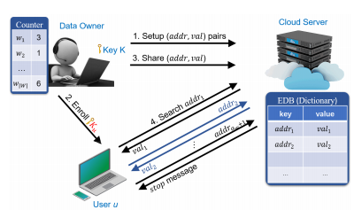
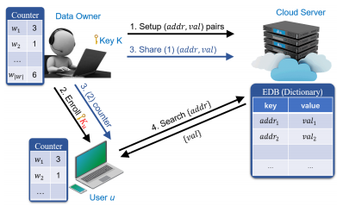
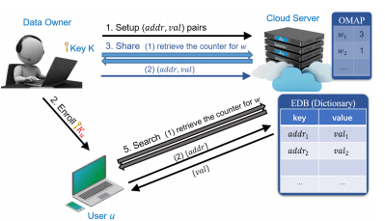

NFNU/FU/FNU
Figure 1:NFNU
Figure 2:FU
$${OMAP}_{U},{aux}_{A}^{D}$$
Figure 3:FNU

Slide 10
THANKS!

